Slide 1

INTERFACING THINGSPEAK WITH BEAGLEBONE BLACK
PROJECT: CAR OVER SPEED DETECTION SYSTEM
SUBMITTEDBY: GOVIND RAJ
ID:C0753448
GROUP #4

Slide 2

CONTENTS
Block diagram
Softwares and hardwares required
Introduction of Thingspeak
Setting up thingspeak
Protocols used
Hardware details
Coding steps
Conclusion
References.

Slide 3
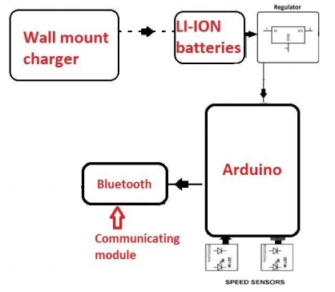
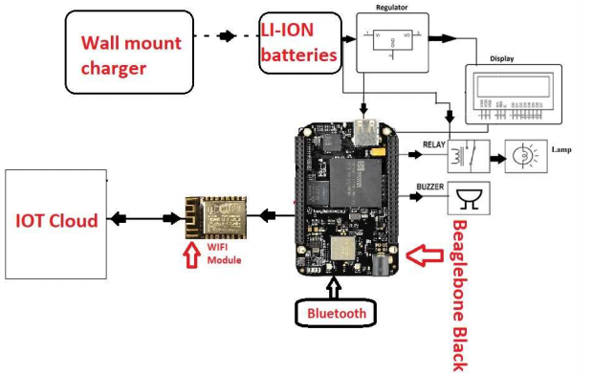
CAR OVER SPEED DETECTION SYSTEM

Slide 4

SOFTWARE AND HARDWARES USED FOR INTERFACING THINGSPEAK
ESP8266 Node MCU
Beaglebone black
Connecting wires
Battery
USB cable
Thingspeak cloud service
Putty
Psftp
Eclipse IDE ,Nano editor
GCC compiler

Slide 5
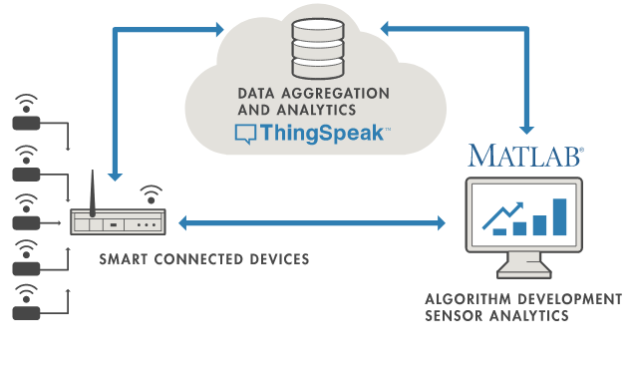
INTRODUCTION
ThingSpeak is an open-source Internet of Things (IoT) application and API
ThingSpeak is a platform for IoT analytics
It allows you to aggregate, visualize and analyses live cloud data streams.
You can send data from your devices to ThingSpeak
It uses the HTTP and MQTT protocol to store and retrieve data over the Internet or via a Local Area Network.
It can generate instant live data visualizations, and send notifications using web services.

Slide 6

SETTING UP THINGSPEAK
Firstly go to thinkspeak.com and create and account
Create a thingspeak account by clicking getting started for free and sign in with mail id and then verifying the id.

Slide 7
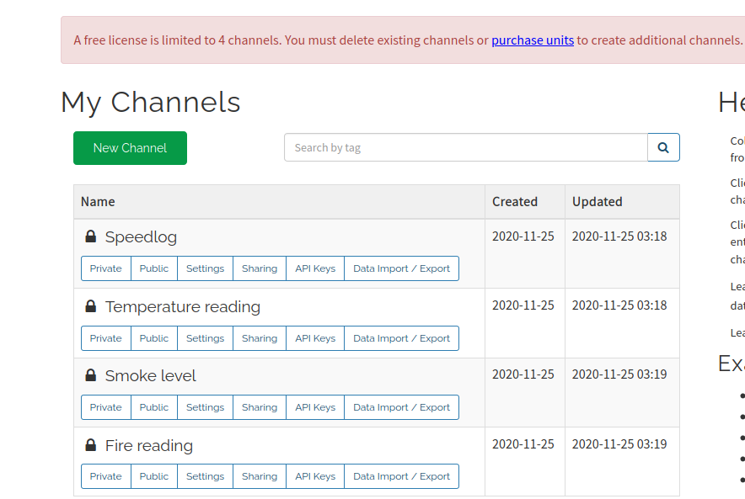
CONTD...
In free trail account we will be able to setup up to 4 channels on lt. In a channel there will be 8 fields.
You will be able to send and receive 8 data at a time to a channel. (means 8 parameter's e.g. temperature, humidity etc..)
Totally from 4 channels and 8 fields we will be able to feed 32 data's to a single account

Slide 8
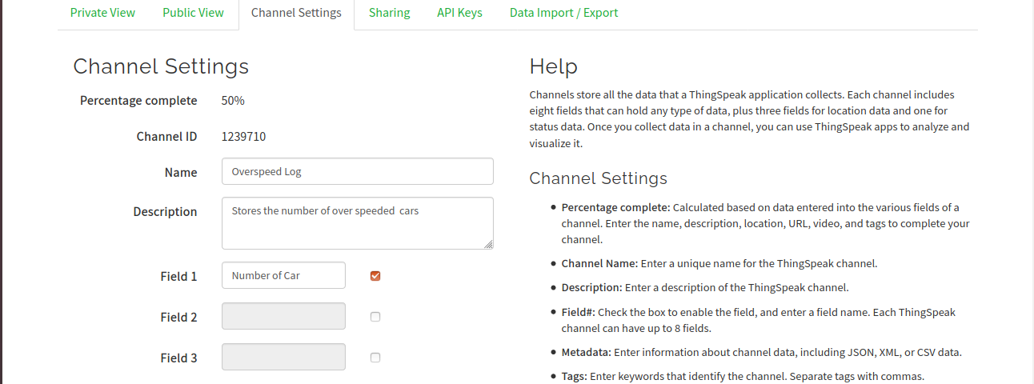
CONTD...
Click on New channel button to create a new channel. Then you will get an interface as shown. We can mention the name of channel, description, field etc...
After doing everything we can just save the channel.
Each channel is identified by unique channel id

Slide 9
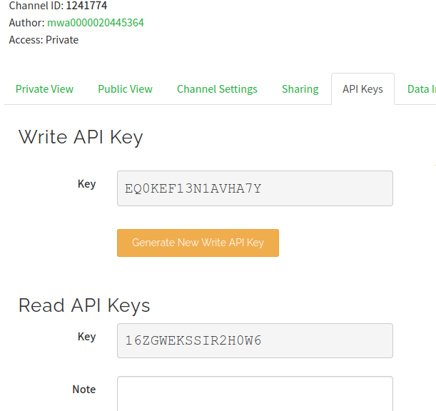
CONTD..
Whenever we write or read data from or to Thingspeak we need to use the API keys found in our account.
We have to copy the API keys to our program
There is an option for regenerate new API key if old one is misplaced. For both write and read API keys there are option to regenerate keys

Slide 10
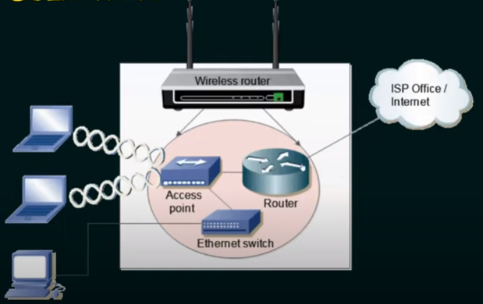
PROTOCOLS USED
IEEE 802.11 Wireless fidelity (wi-fi):
IEEE 802.11 is designed to use in a limited area
All wirless devices connect to internet using wifi. Wifi used radio waves. As shown in figure the laptop is connected top access points using wifi(wireless) and access points are connected to router (wired) and then finally router is connected to internet service provider(wired)

Slide 11
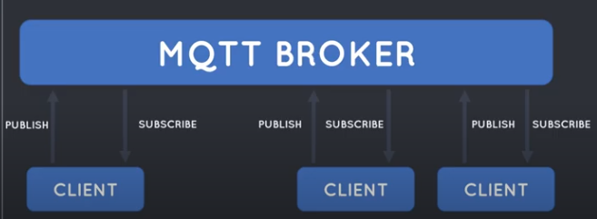
CONTD...
2. MQTT AND ITS WORKING
Is one of the most preferred
protocols for IOT devices .
It stands Message queuing
telemetry transport. Simple
and light weight , open source
and easy to implement
Like any internet protocol mqtt is based on client and server
MQTT server are called a broker and clients are the connected devices
When a device want to send the data we call this operation as publish and when the device want get some data from broker then the operation is called as subscribe.
Broker handles both this operations

Slide 12
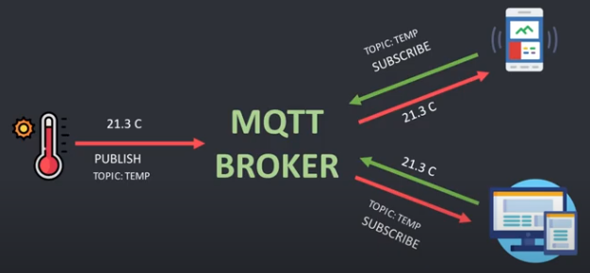
MQTT EXAMPLE

Slide 13
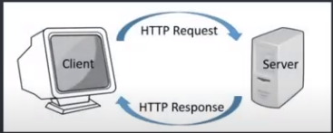
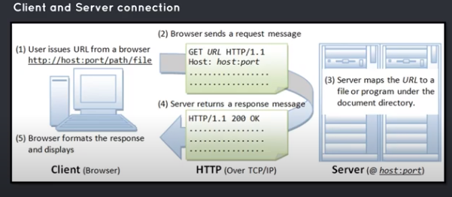
CONTD...
3. HTTP AND ITS WORKING:
Connection between client and server. It is the commonly used protocol for internet. It can be also used by IOT devices that need to push huge amount of data
Hyper Text Transfer Protocol
Client sends a request url
and the browser carries the
URL to server. The server then
processes the request and
send response

Slide 14
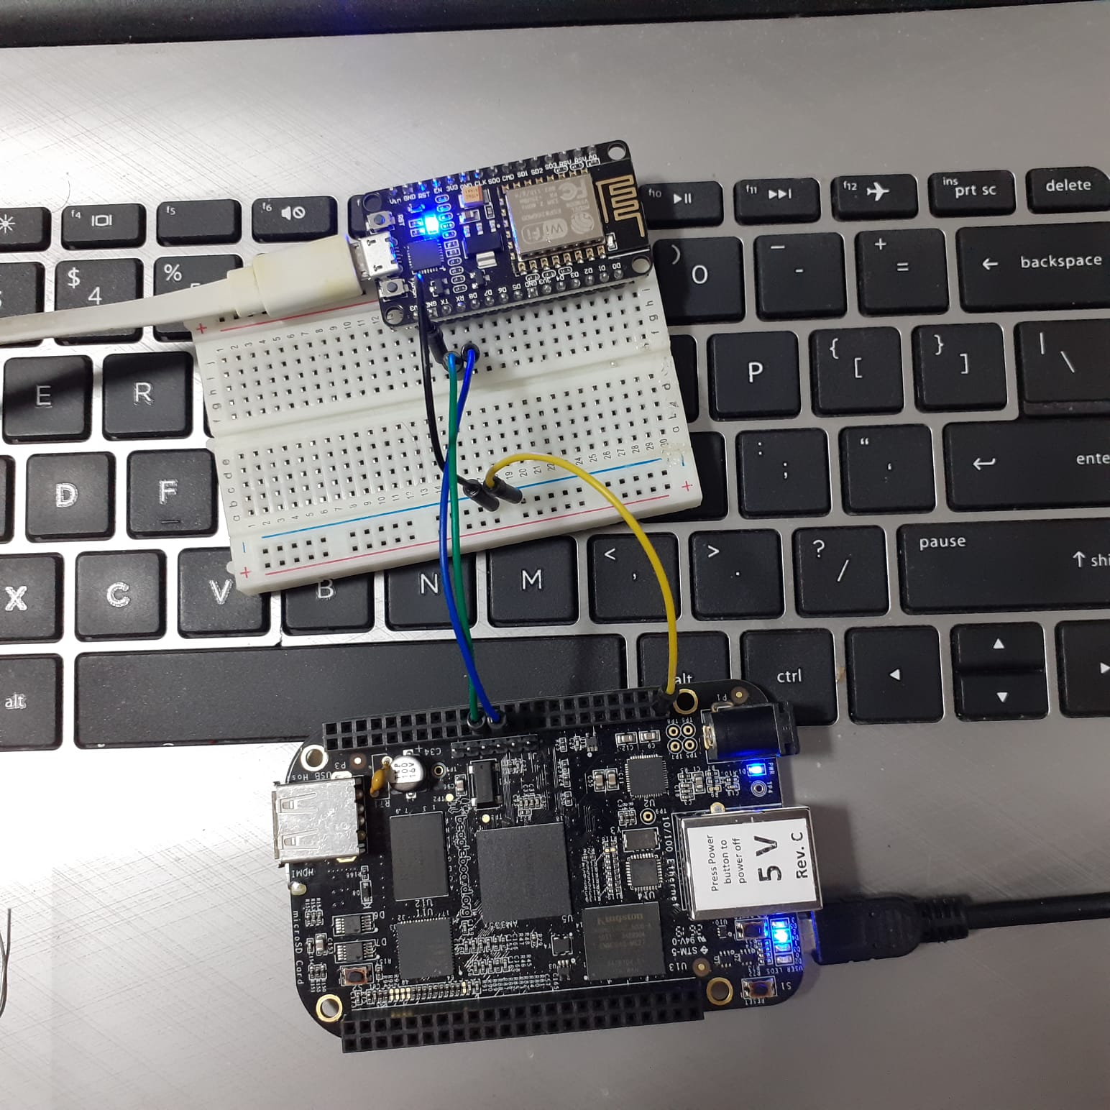
INTERFACING OF ESP8266 WITH BEAGLEBONE BLACK
Jumper wires are used to connect ESP with beaglebone black
ESP8266 node mcu gives wifi functionality to beaglebone black
ESP8266 is programmed using Arduino IDE
ESP can be powered up with 3.3v from BBB but for now I have loaded program using data cable so using same cable for powering up ESP also

Slide 15
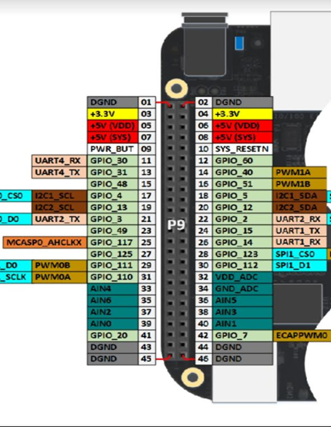
CONNECTION DETAILS
ESP connections to Beaglebone black:
Connections:
ESP | BBB
VCC | SYS 3.3V
GND | GND
RX | P9_24
TX | P9_26

Slide 16
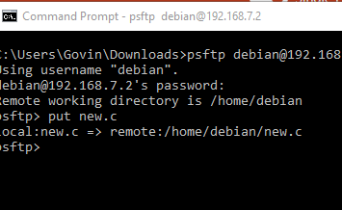
HOW TO USE PSFTP?
Here I am going to say how we can transfer files from our host machine to remote system such as beaglebone black
WinSCP is also an open source sftp client for secure transfer of files, but here I like to say how we can transfer files using psftp which is similar to sftp in linux
Download psftp.exe file and open command prompt then change the directory in which it contains program file
Use command psftp debian@192.168.7.2 and password as"temppwd" to enter into psftp interface and use put "filename" to transfer file

Slide 17
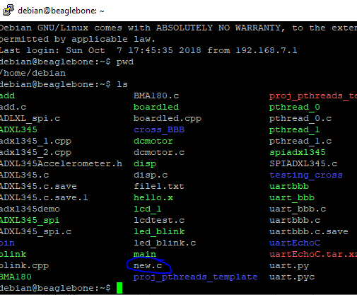
CONT..
Before using psftp open putty and log into beaglebone using its ip address, username and password
Use ls command to see all the files
After using put "filename" command in psftp.exe we can see the file inside beaglebone black

Slide 18
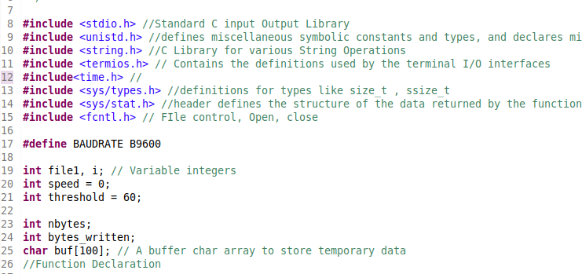
CODING STEPS
Firstly all the header files are written. Stdio.h is used for defining variable types and other input/output operations
String.h-C library for doing string operations
Unistd.h for ulseep()
Sys/types.h definiton for types like
size_t, sszie_t.
Termios.h contains definitons used byterminal I/O interfaces
Fcntl.h is used for file operations.
Sys/stat.h header defines the structure of the data returned by the function

Slide 19
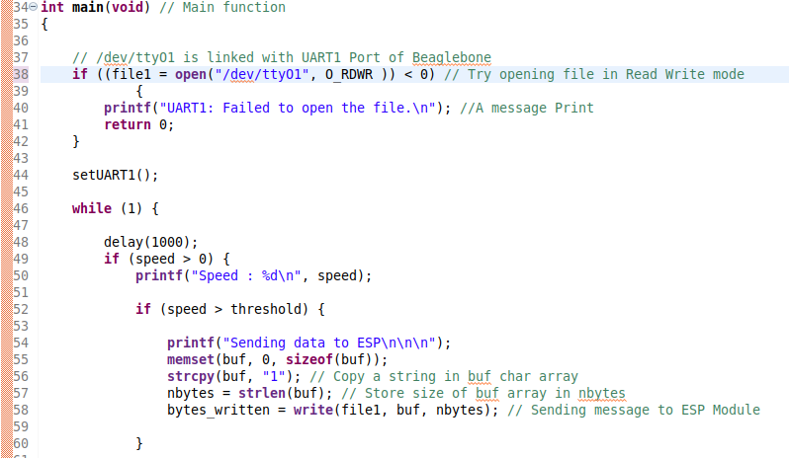
CONTD..
Here we are using UART_1 for interfacing esp with beaglebone black.
So here we are opening "/dev/ttyO1" in read and write mode.
SetUART1() is used to initialize uart1
If speed is greater than threshold the no of car count in a particular day get increases in thingspeak server

Slide 20
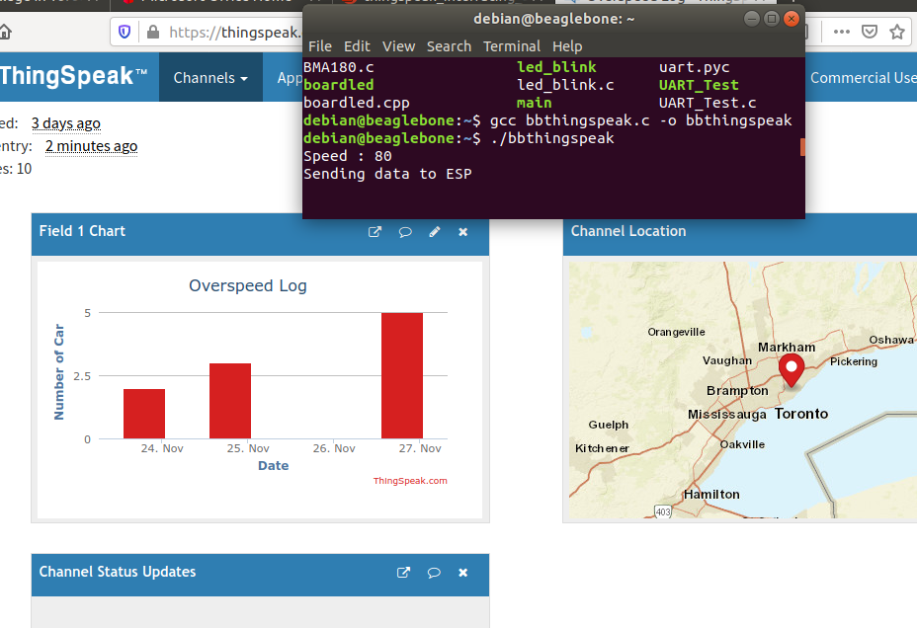
EXECUTION

Slide 21
CONCLUSION
From this task we were able to interface Thingspeak service with Beaglebone black with the help of ESP8266 node mcu.
We were able to see the overspeed car count get updated in Thingspeak and can be seen with respect to date

Slide 22
REFERENCE
Establishing wifi connection.(n.d). Retrieved from: https://tttapa.github.io/ESP8266/Chap07%20-%20Wi-Fi%20Connections.html
Trevor's electronic blog.(n.d). How to get UART serial port working on beaglebone black. Retrieved from https://electronics.trev.id.au/2018/02/09/get-uart-serial-ports-working-beaglebone-black/
Dorn, C(April 23). Setup a Node MCU to communicate with thingspeak. Retrieved from https://medium.com/@chardorn/set-up-a-nodemcu-to-communicate-with-thingspeak-using-mqtt-fbad7556a5bc
Technical Hub(2020, April 18). MQTT vs HTTP. Retrieved from https://www.youtube.com/watch?v=1ujAX-sunQc
Robo india (n.d.).NodeMCU data upload on Thingspeak on Arduino IDE. Retrieved from https://roboindia.com/tutorials/nodemcu-dht11-thingspeak-data-upload/

Slide 23
CONTD...
Tutorialspoint. (n.d). C library function memset(). Retrieved from https://www.tutorialspoint.com/c_standard_library/c_function_memset.htm
MDN web docs. (n.d). Http response status codes. Retrieved from https://developer.mozilla.org/en-US/docs/Web/HTTP/Status
Neso Academy(2020, may 18). IEEE 802.11 Wireless fidelity(wi-fi). Retrieved from https://www.youtube.com/watch?v=t3FVP5wuG4g
Mathworks(2019, Sep 13). Thingspeak-Arduino. Retrieved from https://github.com/mathworks/thingspeak-arduino
Xantium-enterprises(2015,sept 4).Serial port programming on linux. Retrieved from https://github.com/xanthium-enterprises/Serial-Port-Programming-on-Linux/blob/master/USB2SERIAL_Read/Reciever%20(PC%20Side)/SerialPort_read.c

